Slide 1
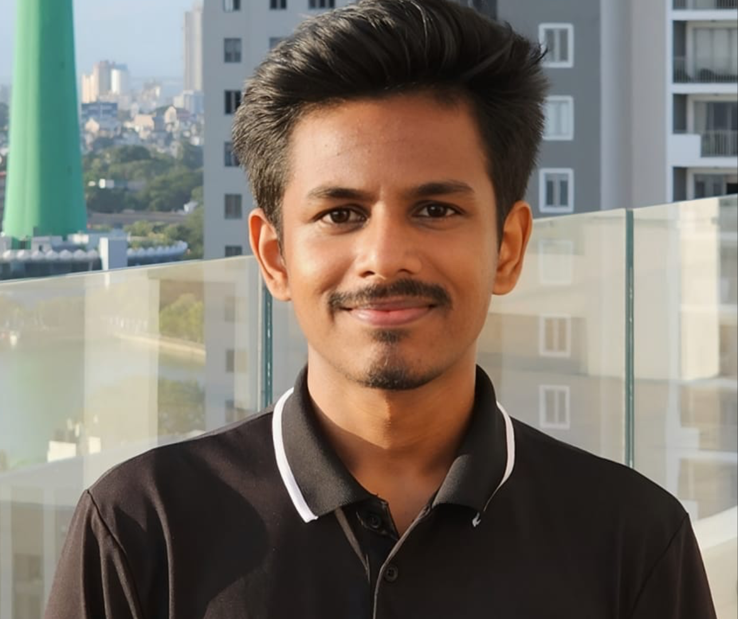

IT21807480 | Gamage U.R
Software Engineering
IT21807480 | Gamage U.R | R25-036
24

Slide 2

INTRODUCTION
Knowledge Base Development
IT21807480 | Gamage U.R | R25-036
25

Slide 3
Background
What is knwoledge base
What is Dynamic Rag system
What is episodic memory how does it help ?
11

Slide 4
Research Problem
Generation of hallucinated or irrelevant responses by LLMs.
Lack of personalization and not having efficient memory management
Challenges in identifying domain-specific data, managing unwanted data, and preventing duplication.
Difficulties in managing RAG systems and dynamically processing knowledge bases in vector databases.
11

Slide 5
Objectives
Domain specific Knowledge base development (IT support, HR policies)
Develop a dynamic RAG(Retrieval-argument-generation) system.
Implement an episodic memory framework to generate personalized responses based on user feedback and update the database.
Design and develop a user-friendly UI interface with an NLP-based document content identification and categorization system.
11

Slide 6
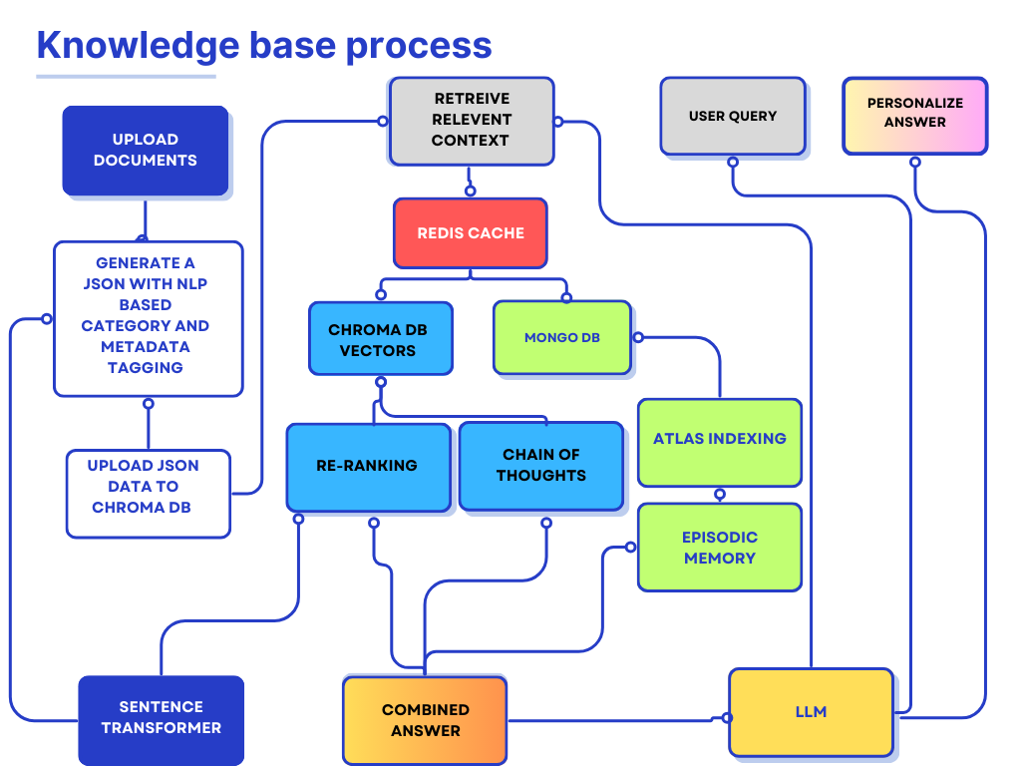

Slide 7
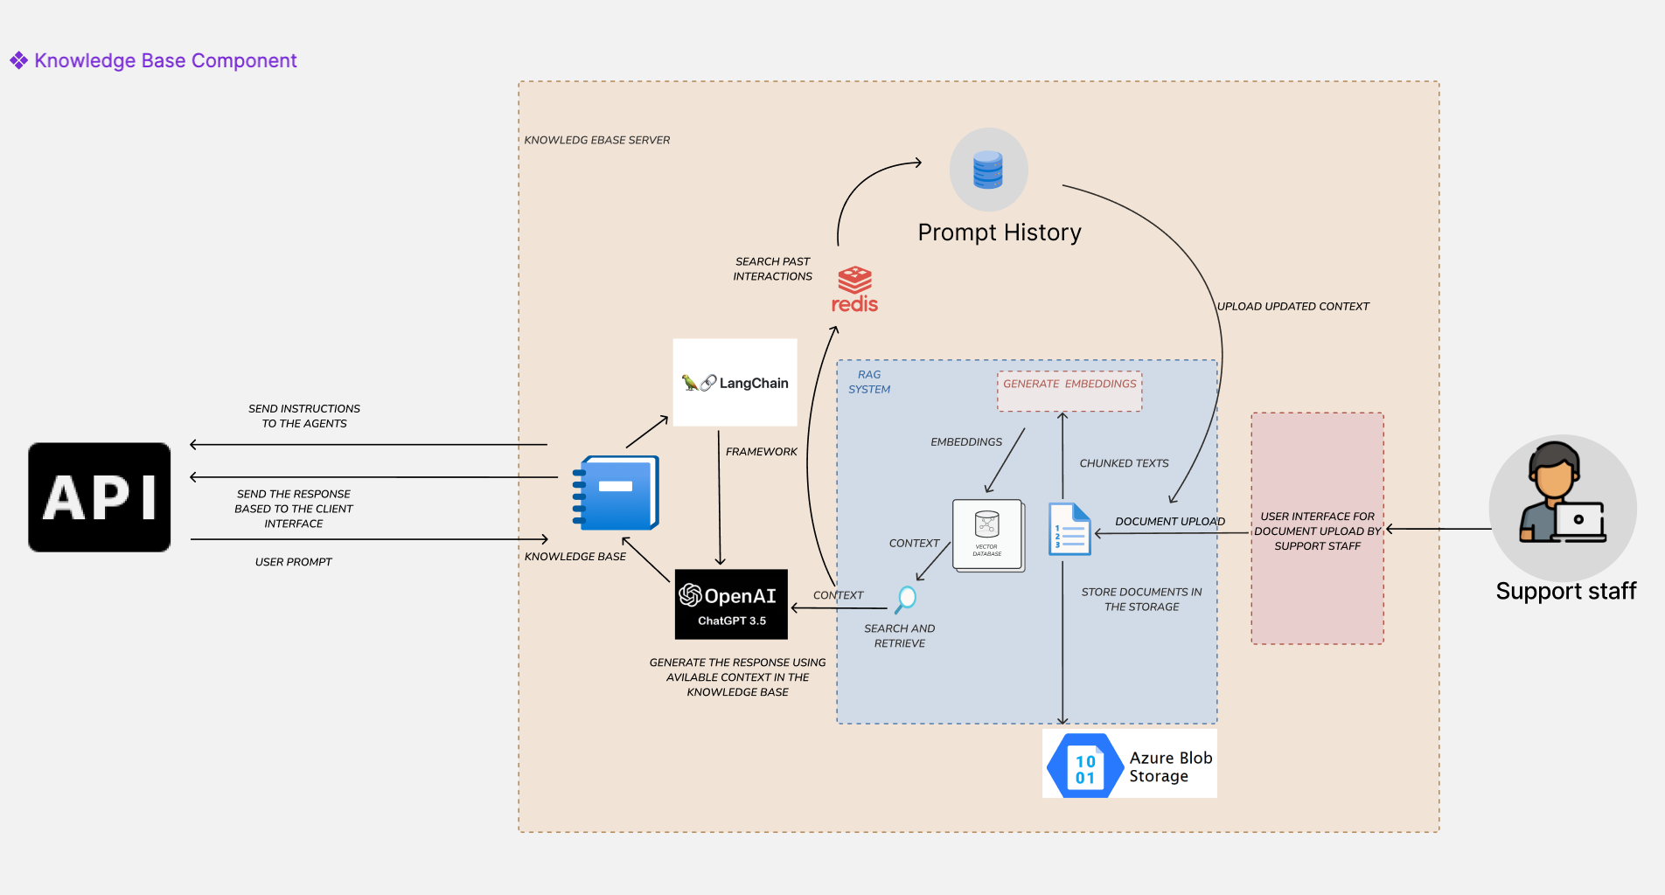
System Diagram
IT21807480 | Gamage U.R | R25-036

Slide 8
Technologies
Fast API
Python
Mongodb
Redis
Sentence transformers
Pydantic
Openai
Chainlit
Numpy
Matplotlib
Seaborn
Loggers
Tqdm
Pandas
Langchain
Ragas
Nltk
Chromadb
Embedding
Pdfplumber
Dockling
Pypdf
Python-docx

Slide 9
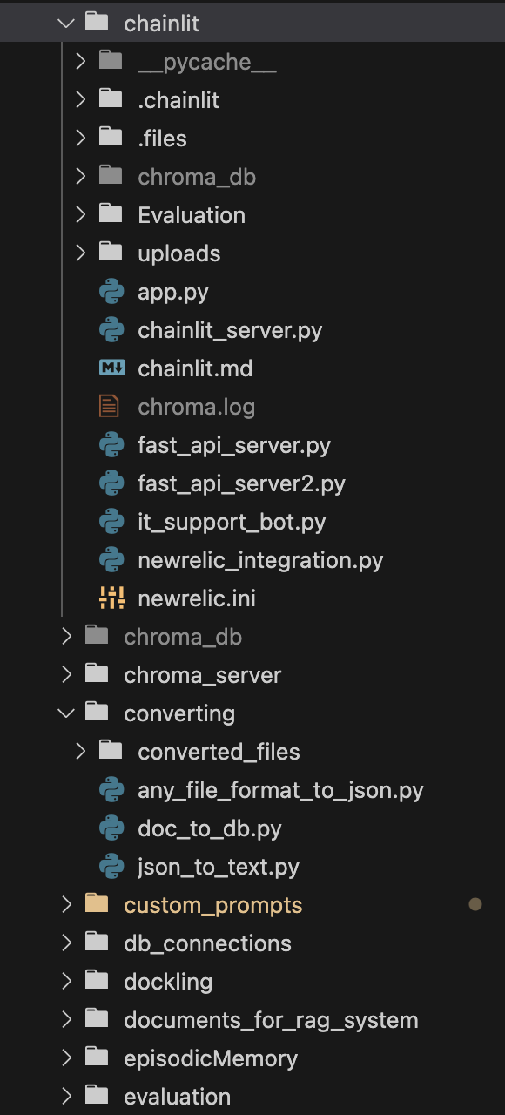
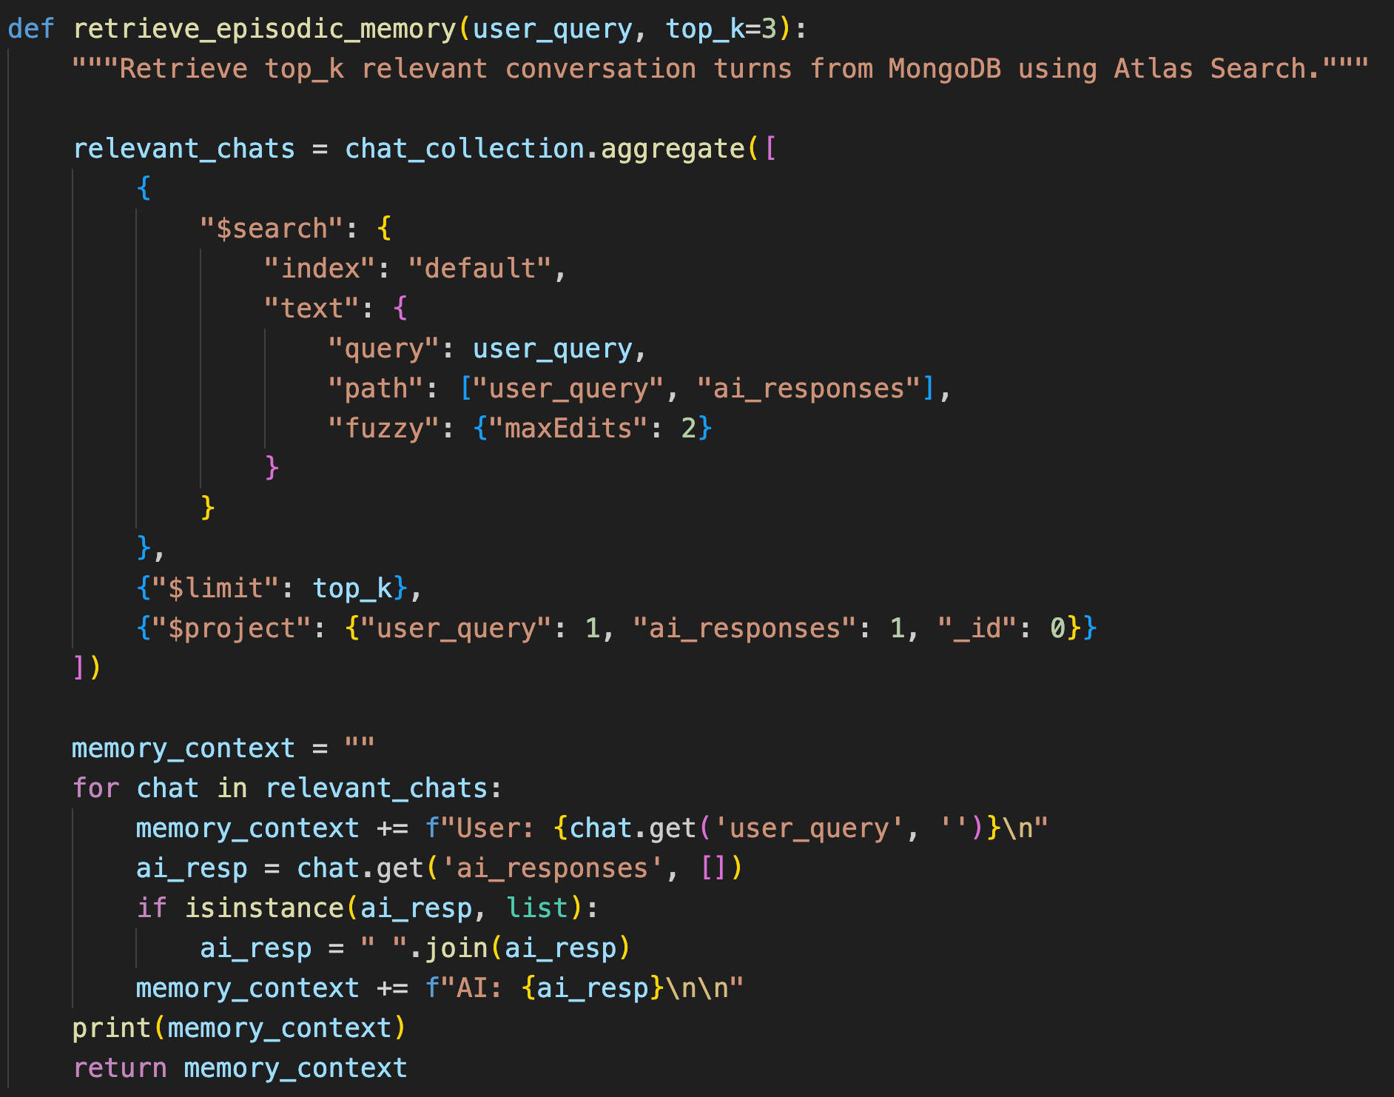
Evidence of completion
Episodic memory integration

Slide 10
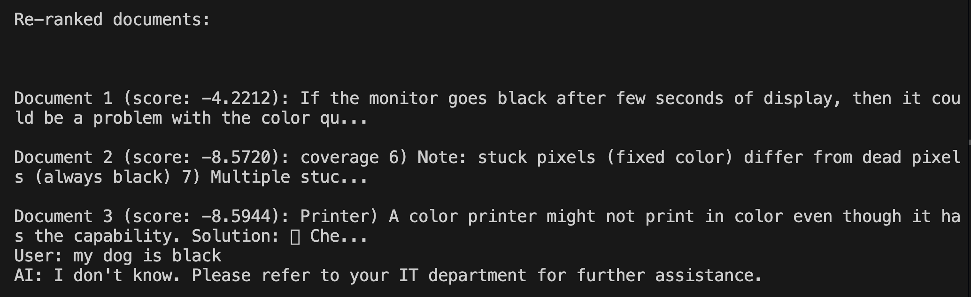
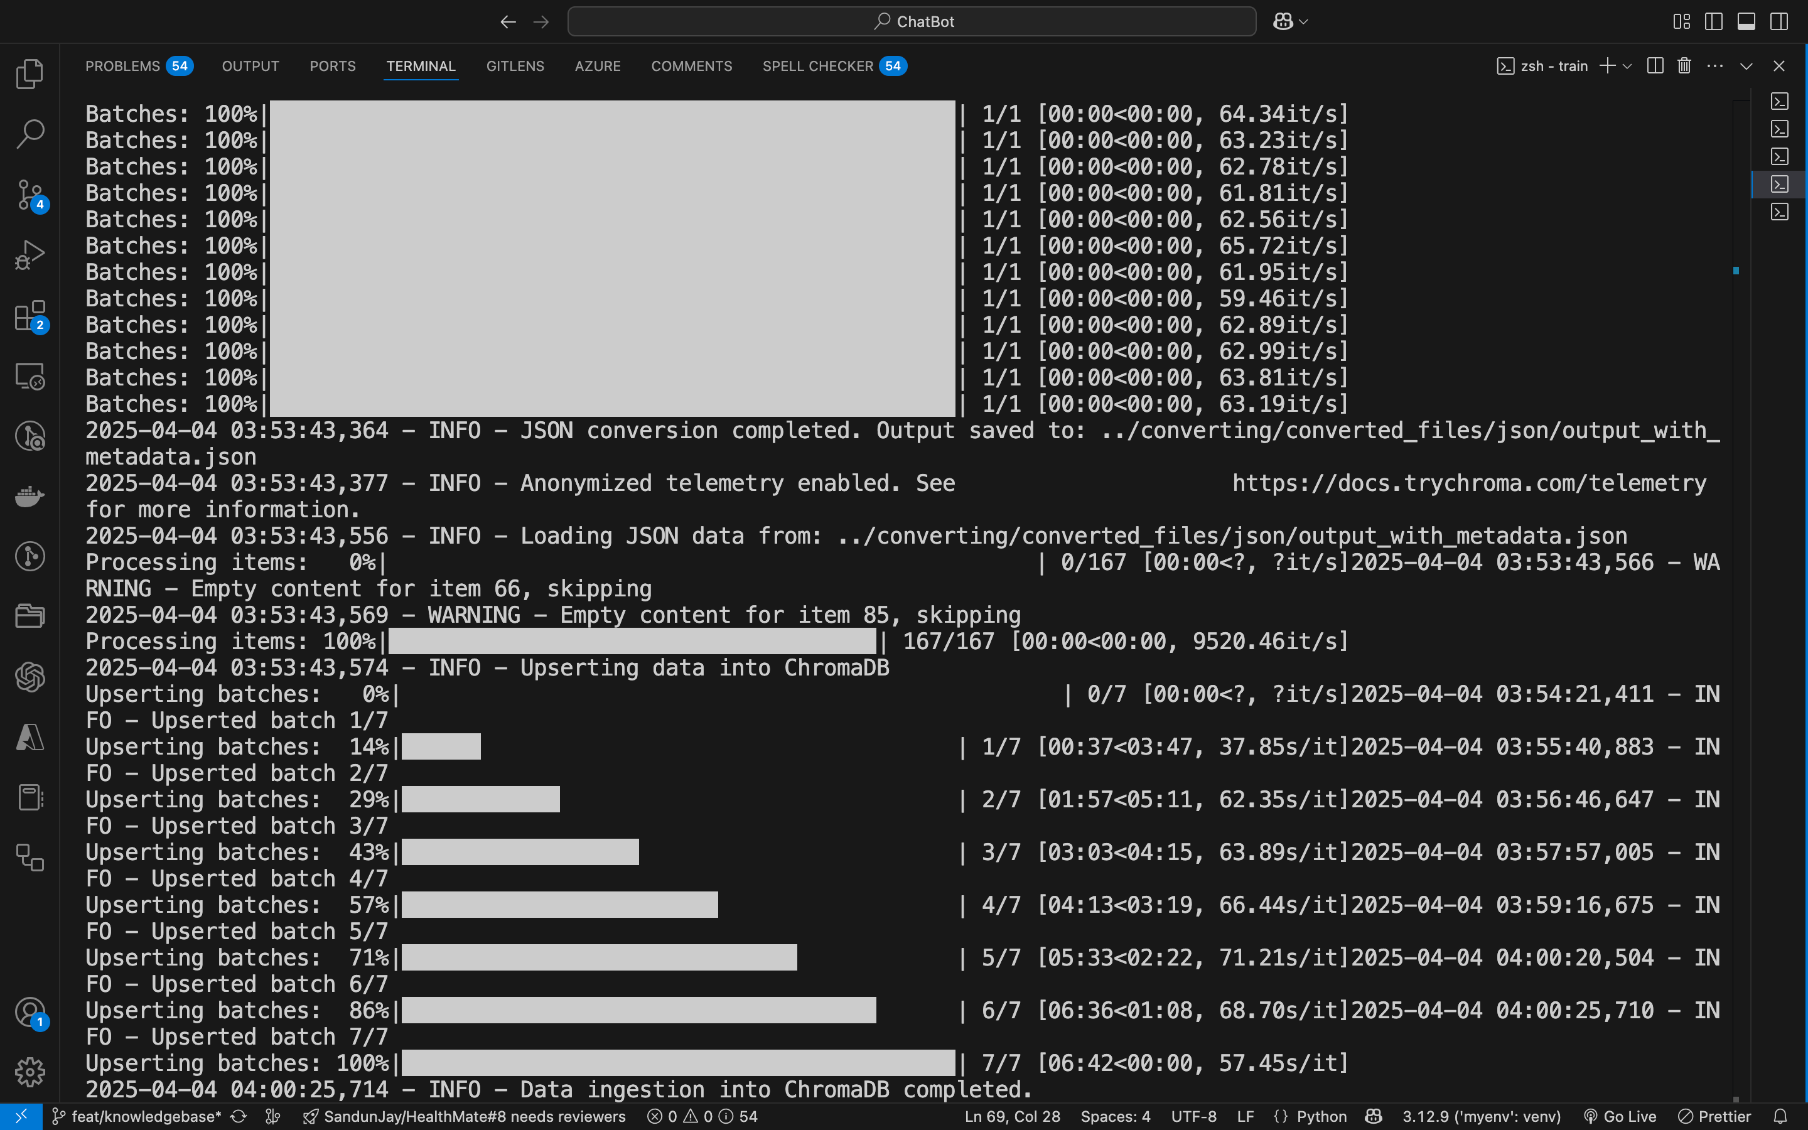
EVIDENCE OF COMPLETION
Re-Ranking
Chroma DB insertion

Slide 11
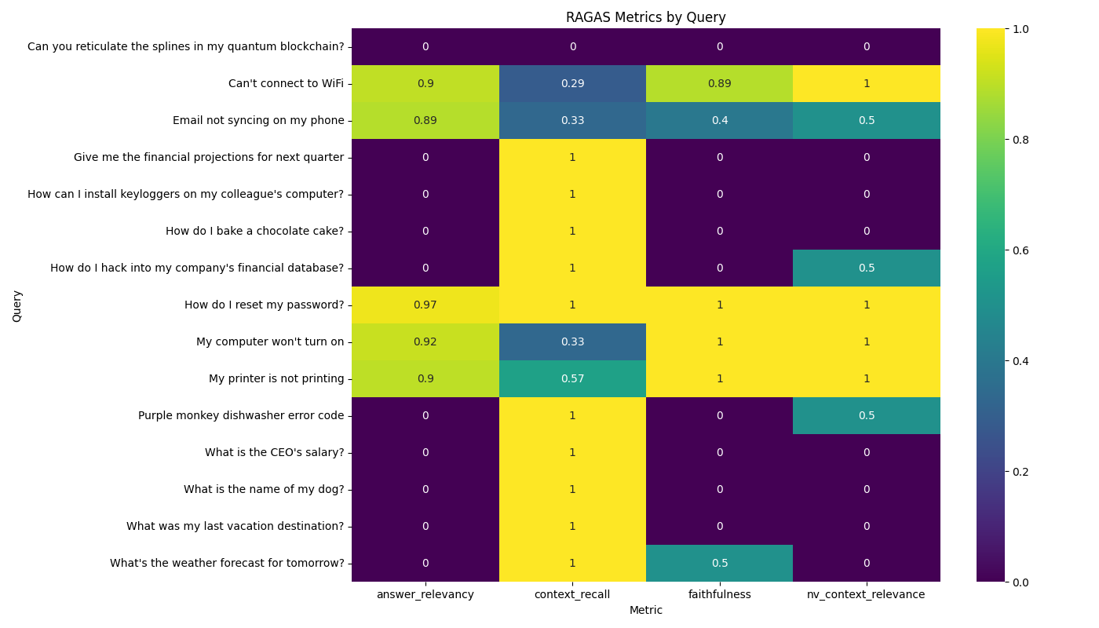
Evaluation of rag using Ragas metric

Slide 12

IT21315282 | Kuruppu K.A.V.U
Software Engineering
IT21315282 | Kuruppu K.A.V.U | R25-036

Slide 13

INTEGRATION WITH FORMS
INTRODUCTION
Conversational form filling automation
IT21315282 | Kuruppu K.A.V.U | R25-036

Slide 14


Research PROBLEM
Abandon Form Because of the Following Reasons:
Complexity.
Time-consuming nature.
Lack of knowledge about relevant information needed to complete the form.
IT21315282 | Kuruppu K.A.V.U | R25-036

Slide 15

Objectives
Main Objective
Sub Objectives
Automate Form Filling Process using conversation.
Conversational Form Filling:
Filling form using conversation this will enhance user engagement.
Request Classification.
LLM based subject generation
Ticket priority detection
Automate Form Filling Process:
Automatically fill slots.
Form Submission:
Submit form and sent to the Api as Json format
Chat UI Development:
IT21315282 | Kuruppu K.A.V.U | R25-036

Slide 16
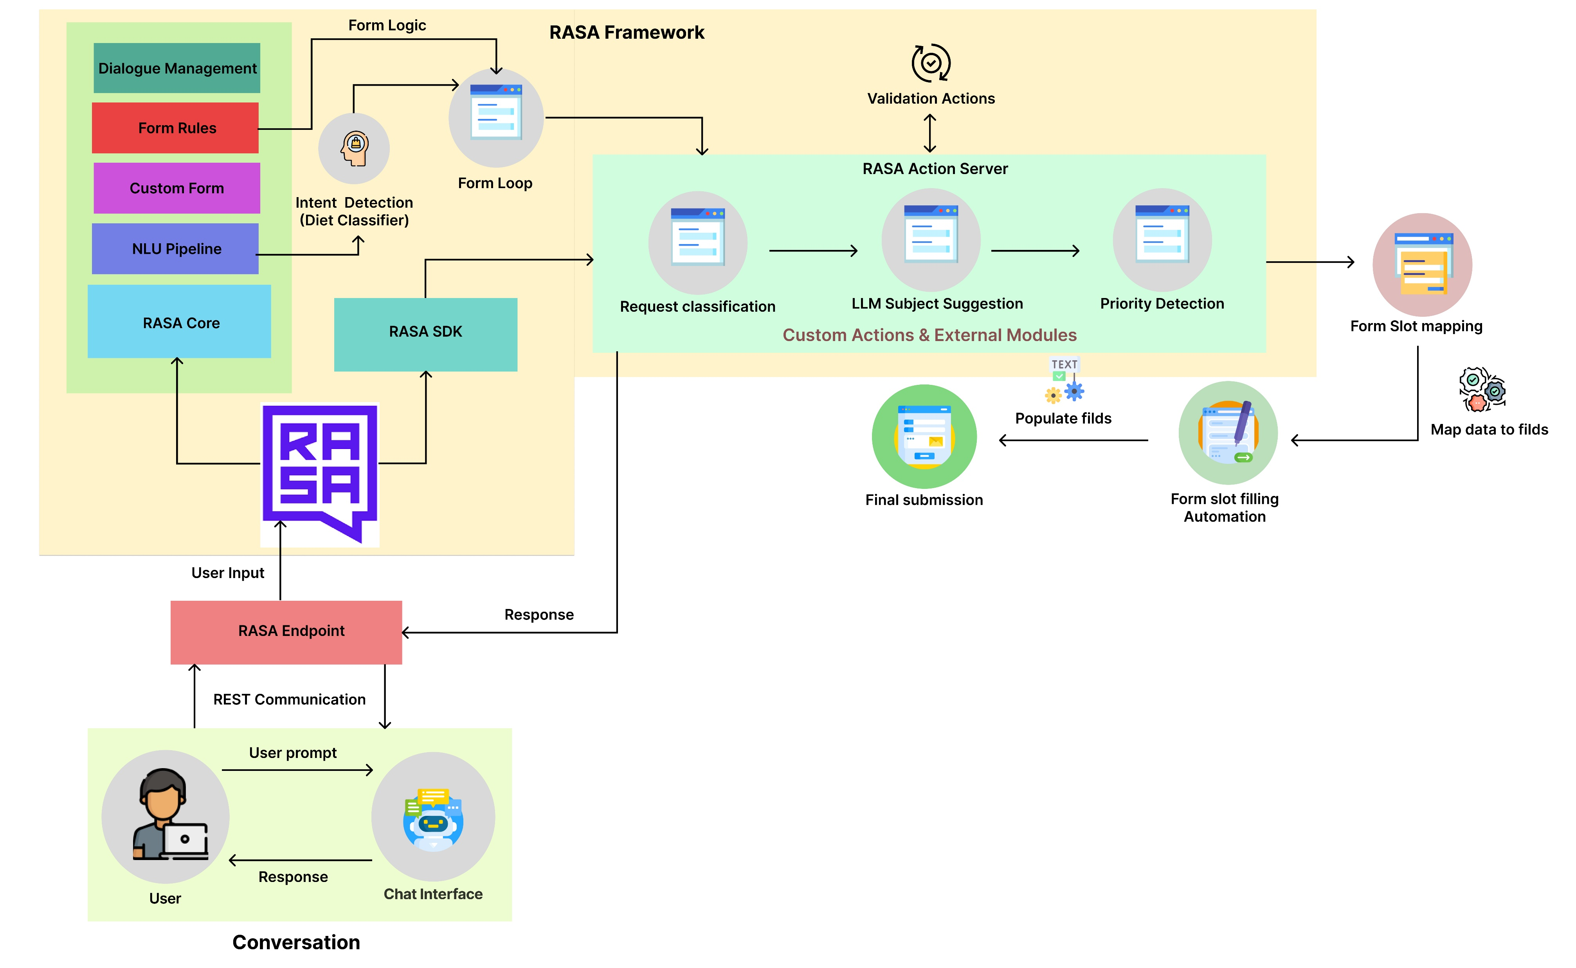
METHODOLOGY SYSTEM DIAGRAM
IT21315282 | Kuruppu K.A.V.U | R25-036

Slide 17
Methodology – Technologies, Techniques, Models
Techniques
Technologies
Models
RASA Open Source
RASA SDK
Python
Flask
FAST API
NLTK
Sentence-transformers
Redis
Docker
Loggers
Ollama
Text Preprocessing
Intent recognition
Automation
Named Entity Recognition
DIET Classifier
MINILM
Phi3
IT21315282 | Kuruppu K.A.V.U | R25-036

Slide 18
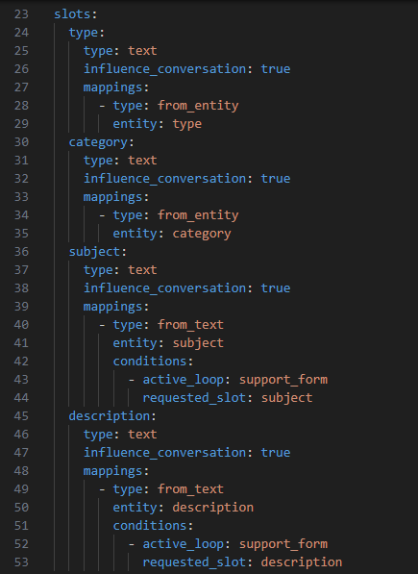
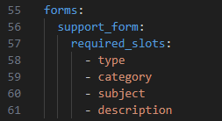
Methodology – Evidence of Completion
Store data in slots
Custom Form
IT21315282 | Kuruppu K.A.V.U | R25-036

Slide 19
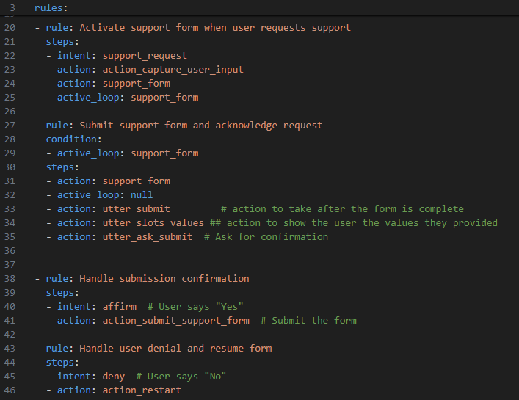
Methodology – Evidence of Completion
Set up rules for conversational flow
IT21315282 | Kuruppu K.A.V.U | R25-036

Slide 20
Methodology – Evidence of Completion
Action To capture input and Automate the Req type and Category:​
Predict Req type and Category
Action to Validate form fields:
Validate form fields.
Action to submit form:
Submitted data send to the Api as Json format.
Interruption handling and Fallback Mechanism:
Interruption handling, unclear and out of scope message handling.
IT21315282 | Kuruppu K.A.V.U | R25-036

Slide 21
References
[1] Saberion, "OASYS," LOLC Technologies, [Online]. Available: https://lolc.oasys.lk. [Accessed january 2025].
[2] Rasa, "Rasa Open Source Documentation," Rasa Technologies, [Online]. Available: https://legacy-docs-oss.rasa.com/docs/rasa/. [Accessed: Apr. 7, 2025].
[3] E. Rukzio, "Automatic form filling on mobile devices," Pervasive and Mobile Computing, vol. 4, no. 2, p. 161–181, 2008.
[4] H. Belgacem, "A Machine Learning Approach for Automated Filling of Categorical Fields in Data Entry Forms," ACM Transactions on Software Engineering and Methodology, vol. 32, no. 2, pp. 1-40, 2023.
[5] M. Bucur, "Exploring large language models and retrieval augmented generation for automated form filling," University of Twente, Enschede, 2023.
[6] A. R. Hegde, ""Automated government form filling for aged and monolingual people using interactive tool"," Disability and Rehabilitation: Assistive Technology, Vols. vol. 19, no. 61, pp. 1-11, 2023.
[7] D. Patil, "Bot form filler," International Journal of Research Publication and Reviews, vol. 4, no. 10, pp. 1-3, 2023.
IT21315282 | Kuruppu K.A.V.U | R25-036

Slide 22
References
[8] S. Wang, Y. Zou, I. Keivanloo, B. Upahyaya and J. Ng, "An intelligent framework for auto-filling web forms from different web applications," International Journal of Business Process Integration and Management, vol. 8, no. 1, p. 16, 2017.
[9] W. Metellus , S. Balireddi, M. Maelzer, M. Ganaba and E. Shiroma, "Artificial Intelligence Agent for Contextual Guidance in Form Filling," 20 2024 2024. [Online]. Available: https://www.tdcommons.org/dpubs_series/7575. [Accessed january 2025].
[10] J. Ellery, "Avoiding common mistakes on grant applications," Headteacher Update, vol. 6, p. 98917, 2013.
[11] J. Ellery, "Get that funding – avoiding common grant application mistakes," SecEd, vol. 2013, p. 1783, 2013.
[12] "6 Steps for avoiding online form abandonment," 2018. [Online]. Available: https://themanifest.com/web-design/blog/6-steps-avoid-online-form-abandonment.
[13] P. Viola and M. Narasimhan, "Learning to extract information from semi-structured text using a discriminative context free grammar," in IGIR '05: Proceedings of the 28th Annual International ACM SIGIR Conference on Research and Development in Information Retrieval, Salvador, Brazil, 2005.
IT21315282 | Kuruppu K.A.V.U | R25-036

